Slide 1
Weed and Water Stress Detection using Drone Video
Fazeeia Mohammed, Roganci Fontelera, Jade Chattergoon, Patrick Hosein, Omar Mohammed

Slide 2
FAAIR was supported by the National Geographic Society and Microsoft through the AI For Earth Innovation Challenge.
In addition the project also received support through a donation of GPUs from NVIDIA.

Slide 3
Related Works
Precision agriculture has allowed farmers to make data driven changes to their fields to optimize yield.
Work on weed detection was done by Hassanein et al whereby a new weed detection methodology was introduced. This methodology used a low-cost UAV system for detecting the high-density vegetation spots as indication for weed patches in various cropped agricultural fields at various flight heights.
This project’s approach on weed detection differs from Hassanein et al by implementing a pixel classification approach, our team’s goal is to produce highly accurate weed detection results for every individual weed plant.

Slide 4
Irrigation scheduling technique has become crucial for smart water usage in agriculture. Soil moisture measurements and meteorological variables are traditionally used for monitoring crop water stress by estimating the amount of water lost from a plant-soil system.
These approaches are labour intensive, destructive and unsuitable for automation.
Custom software will be built around the models to provide insights to farmers.

Slide 5
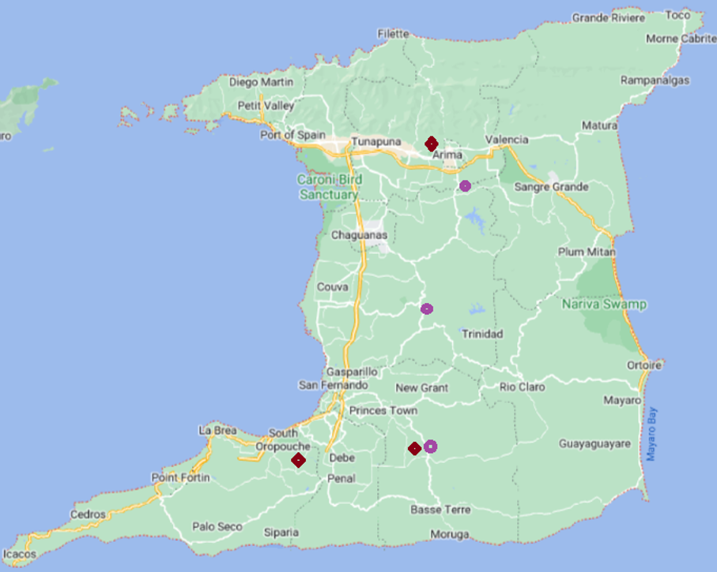
Data Collection
This project was aimed at applying some large scale agricultural techniques to Caribbean islands in spite of their unique challenges such as small scale farming while provide insights leading to increased crop yield in the face of climate change.
These plants were selected because of their life cycles, distinction, and availability.

Slide 6
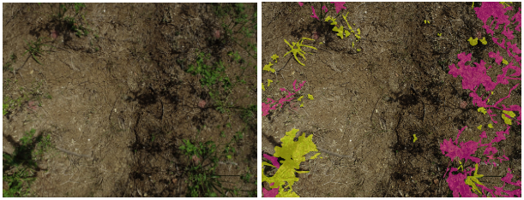
Data Labelling
Video was collected from the drone flights.
The videos were sliced by frames .
Frame selection was done on the basis of clarity, overlap and minimal artefacts.

Slide 7
Data Labelling
The images were labelled using the Image Labelling application in MATLAB.
Labelling of the images required the person labelling to manually zoom into the image at very high magnification rates to ensure accurate labelling .
Agricultural experts were consulted during this process to ensure the integrity of the data labelling process.

Slide 8
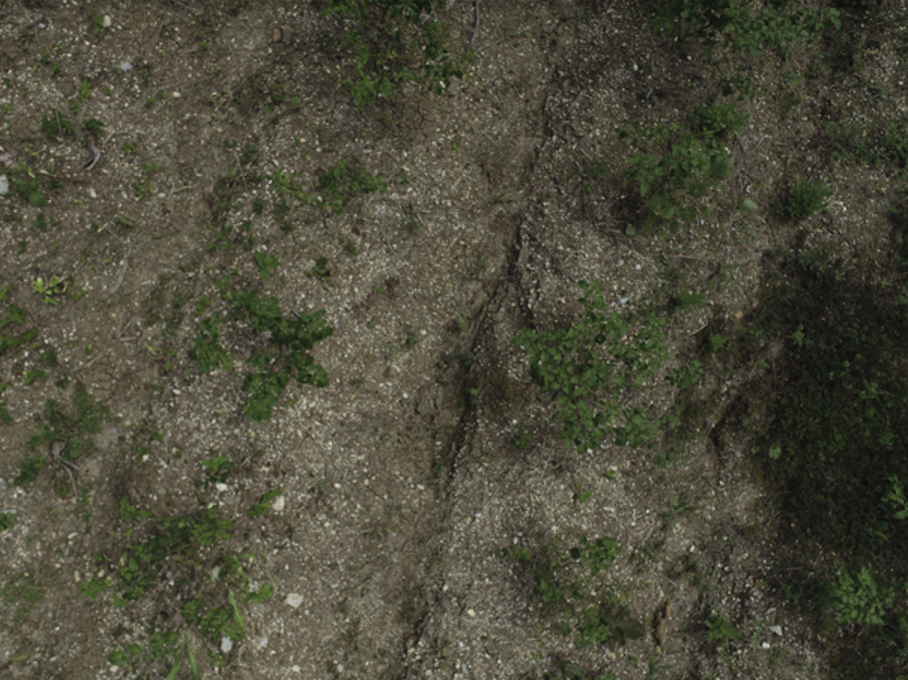
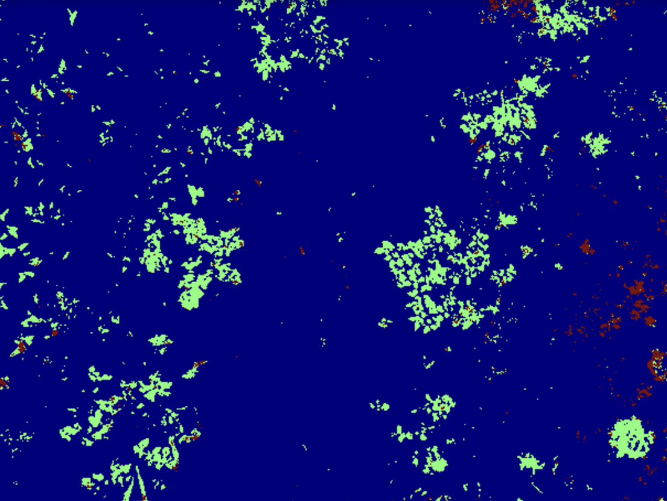
Model creation
This image shows the XGBoost model prediction for weed in brown and crops in green for the weed detection problem.
This output was done on test data collected at the same site as data collection.

Slide 9
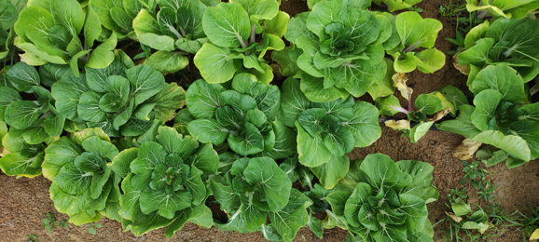
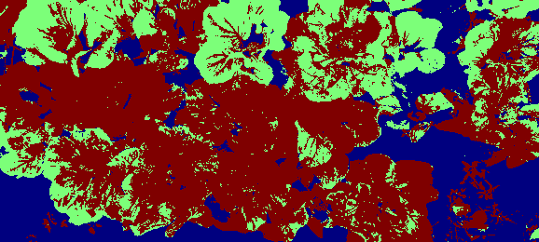
The above images are the original and an XGBoost model prediction this is used to supply farmers with insights on areas of water stress indicated by the green colour in the prediction image.

Slide 10
Models Creation
Model | Accuracy
SVM | 0.48
Random Forest | 0.88
Naive Bayes | 0.32
XGBoost | 0.92
U-Net | 0.79
Seg-Net | 0.76
Deep Lab | 0.71
Overall, the best performing model for weed detection is XGBoost at 92% accuracy.
Model | Accuracy
SVM | 0.37
Random Forest | 0.70
Naive Bayes | 0.40
XGBoost | 0.76
U-Net | 0.48
For water stress detection XG Boost also performed the best at about 70% accuracy.

Slide 11
Challenges and Limitations
The project began during COVID resulting in difficulties related to attaining a drone. Numerous restrictions and lockdowns at that time placed limitations on data collection.
In its use the drone is limited to clear days with minimum rainfall. In a tropical island this was a major limitation.
The location of the drone survey must have a strong GPS signal for take off. In addition excessive green vegetation and a high concentration of heavy metals in soil affects the drones connectivity to the controller.
There was a human resource limitation on individuals trained to pixel label data.

Slide 12
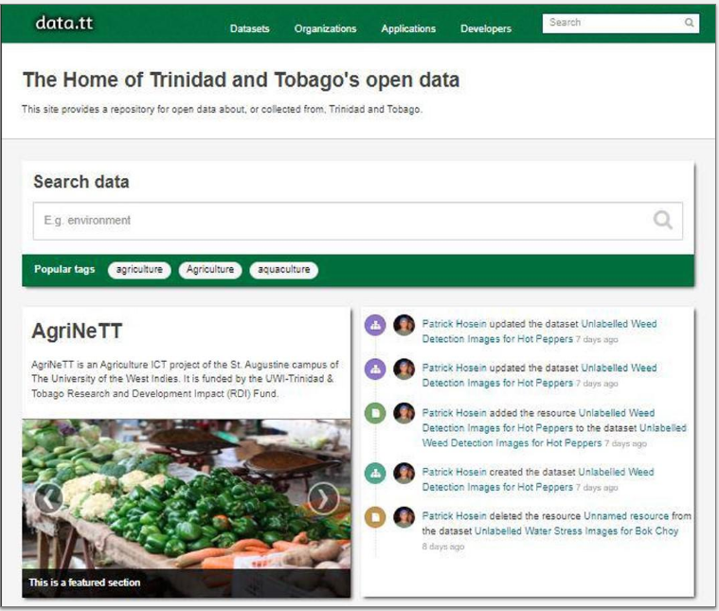
Platform for Data Access
Using the images that were collected and labelled, four data sets were uploaded to the repository data.tt.
All data sets available on this site were collected from or are directly related to Trinidad and Tobago.
Collections of data sets are published under Organisations and can also be viewed by tags, groups, file formats and licences.

Slide 13
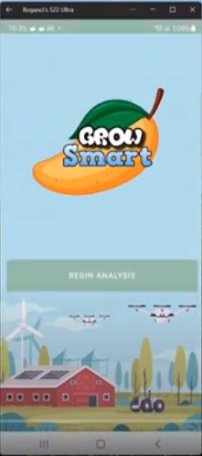
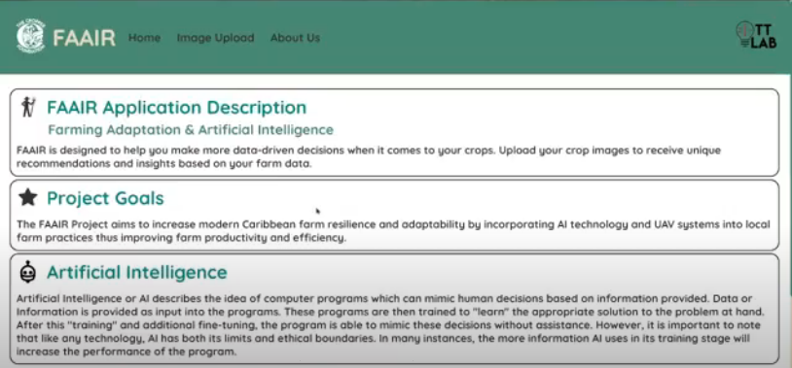
Applications Created
Both a web and mobile application were created based on the models trained.

Slide 14
Conclusion
Overall, the project enabled the real time and rapid assessment of smallholder crop and water stress detection using machine learning models.
By generating landscape data, reducing reliance on post-processing expertise and expensive satellite imagery, the project will increase the adoption of AI for climate smart agriculture in the Caribbean.

Slide 15
Future Applications
Detect Plant Disease
Estimate crop yields
Creating datasets to include more crop types
The ability to use the applications with or without an internet connection snf increasing the efficiencies with image processing and model predictions.

